Slide 1

Basic Neural Network
Learning Objectives:
Build a logistic regression model structured as a shallow neural network
Gradient calculation, and optimization implementation (gradient descent)
Implement computationally efficient and highly vectorized versions of models
Compute derivatives for logistic regression, using a backpropagation mindset
Use Numpy functions and Numpy matrix/vector operations
Implement vectorization across multiple training examples
Explain the concept of broadcasting

Slide 2
Basic Neural Network
1 Binary Classification
2 Logistic Regression
3 Logistic Regression cost function
4 Gradient Descent
5 Derivatives
6 Computation Graph
7 Derivatives with a Computation Graph
8 Logistic Regression Gradient descent
9 Gradient descent on m examples
10 Vectorization
11 Vectorizing Logistic Regression
12 Vectorizing Logistic Regression’s Gradient Output
13 Broadcasting in Python
14 Explanation of logistic regression cost function (Optional)

Slide 3
Basics of Neural Network Programming
Binary Classification

Slide 4
Binary Classification
Binary classification is a supervised learning algorithm that classify input data into one of two categories or classes. The output of the algorithm is a binary decision, such as "yes" or "no", "true" or "false", or 1 or 0.
The goal is to learn a model that can correctly classify new input data based on patterns or features extracted from the input data.
Examples: predict whether an email is spam or not spam, or to recognize whether an image contains a cat or not.
Logistic regression is an algorithm used to solve the binary classification problems.
Consider example in the next slide.
Notes:
Binary classification is a type of machine learning problem where the goal is to classify input data into one of two categories or classes. In other words, the output of the algorithm is a binary decision, such as "yes" or "no", "true" or "false", or 1 or 0. The goal is to learn a model that can correctly classify new input data based on patterns or features extracted from the input data. An example of binary classification is to predict whether an email is spam or not spam, or to recognize whether an image contains a cat or not.
Logistic regression is an algorithm used to solve the binary classification problems.
Consider example in the next slide.

Slide 5

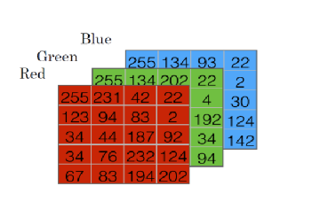
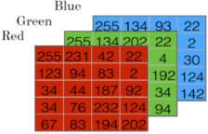
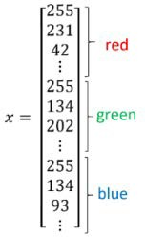
Binary Classification
y = 1 (cat) vs 0 (non cat)
Notes:
Lable đánh nhãn phân biệt 2 loại giá trị
Logitic return ra nhãn còn linear ra real values
Logitic là linear nhưng thêm đưa qua signmoi để gán nhãn
Redu lấy giá trị + còn – mặc đinh = 0 để bảo toàn giá trị + (hàm kích hoạt)
Vector 64x64x3 có length là chính nó

Slide 6
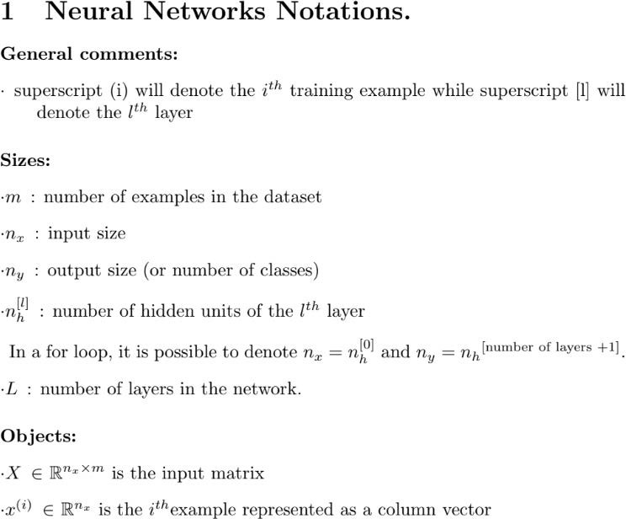
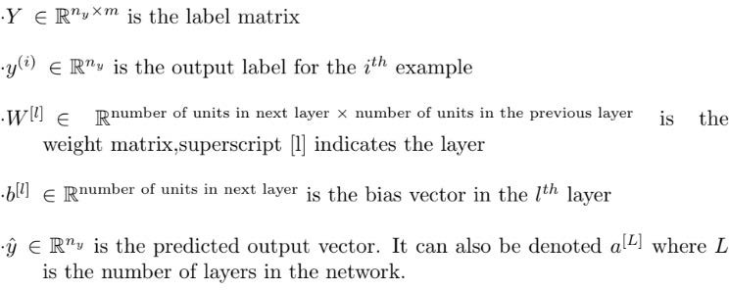
Notation

Slide 7
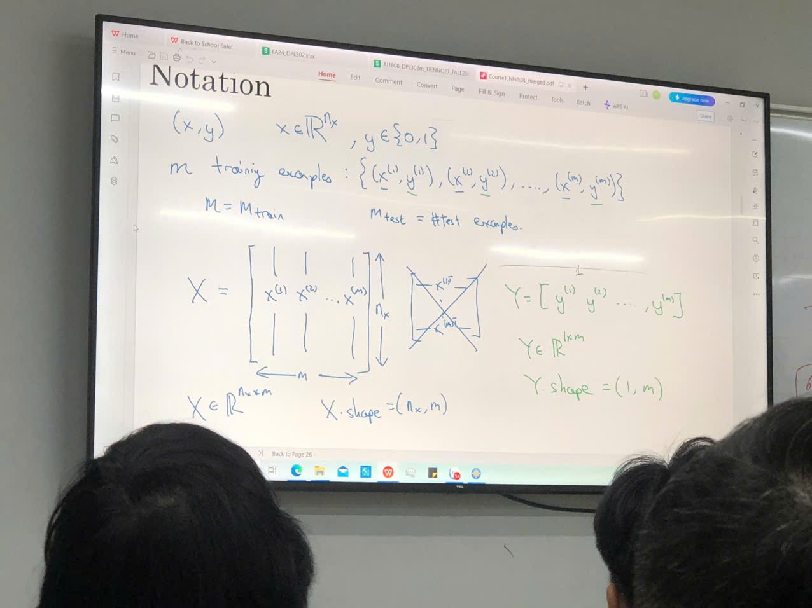
Add
Notes:
Nếu một dataset có 64x64x3 = 12,288 (là nx) =>là 1 fixel => là 1 feature
Nếu có 1000 ảnh (mỗi ảnh xem là 1 vecto =>thì X [x1,x3…x1000]

Slide 8
Basics of Neural Network Programming
Logistic Regression

Slide 9
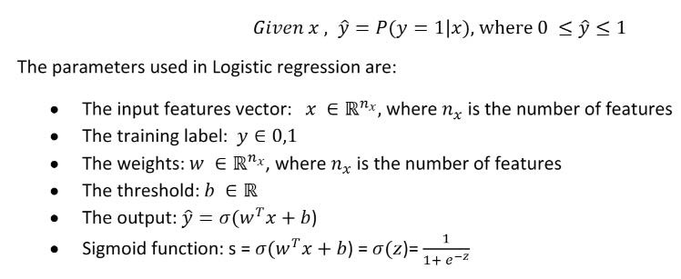
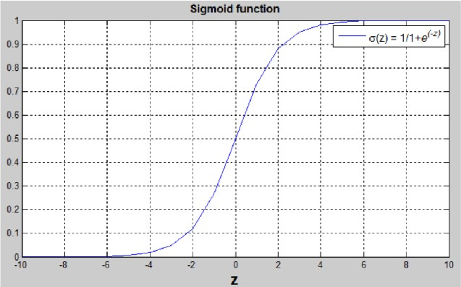
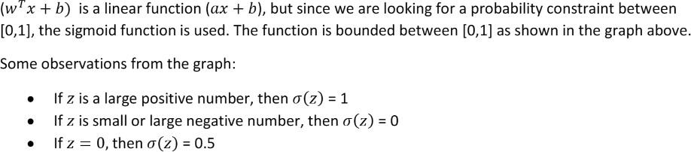
Logistic Regression

Slide 10
Basics of Neural Network Programming
Logistic Regression cost function

Slide 11
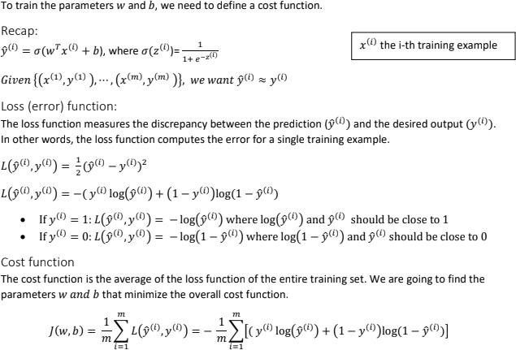
Logistic Regression cost function
X
Y
F(x)
Notes:
Loss(L)tính tại 1 điểm data(x,y)
Ex:Vector ([1,0,0,1,0]), lable([1,0,0,0])
Cost(J)của nhiều overall cost(nhiều điểm)

Slide 12
Basics of Neural Network Programming
Gradient Descent

Slide 13
Gradient Descent
Gradient descent is an optimization algorithm commonly used in machine learning and deep learning to minimize the error or loss function of a model.
The goal is to find the optimal set of parameters (weights and biases) for a given model that minimizes the difference between the predicted output and the actual target values.
The ideal is to iteratively update the model's parameters in the direction of the steepest descent of the loss function.
Some variations of gradient descent: batch gradient descent, stochastic gradient descent, and mini-batch gradient descent.
Notes:
Gradient descent is an optimization algorithm used to minimize a cost function by iteratively adjusting the values of the parameters of a model. It is commonly used in machine learning to update the weights and biases of a neural network during training.
The idea behind gradient descent is to calculate the gradient of the cost function with respect to each parameter, which gives us the direction and magnitude of the steepest ascent. We then take small steps in the opposite direction of the gradient to descend the cost function, towards a local minimum. The size of each step is determined by the learning rate, which is a hyperparameter of the algorithm. If the learning rate is too small, the algorithm may take a long time to converge to the minimum, while if it is too large, it may overshoot the minimum and fail to converge.
There are different variations of gradient descent, such as batch gradient descent, stochastic gradient descent, and mini-batch gradient descent, which differ in how the gradients are calculated and how the steps are updated.

Slide 14
Gradient Descent
How the gradient descent algorithm works:
Initialization: Start with an initial set of parameter values randomly or using some predefined values.
Forward Pass: Feed the input data into the model to obtain the predicted output.
Loss Calculation: Calculate the difference (error) between the predicted output and the actual target values using the chosen loss function.
Gradient Calculation: Compute the gradient (partial derivatives) of the loss function with respect to each model parameter. This step tells us the direction and magnitude in which the parameters should be adjusted to reduce the loss.
Parameter Update: Update the model parameters by moving them in the opposite direction of the gradient (descending the loss function). The size of the update is controlled by a learning rate, which determines the step size in the parameter space.
Repeat: Repeat steps 2-5 for a predefined number of iterations or until the loss reaches an acceptable level.
Notes:
Gradient descent is an optimization algorithm used to minimize a cost function by iteratively adjusting the values of the parameters of a model. It is commonly used in machine learning to update the weights and biases of a neural network during training.
The idea behind gradient descent is to calculate the gradient of the cost function with respect to each parameter, which gives us the direction and magnitude of the steepest ascent. We then take small steps in the opposite direction of the gradient to descend the cost function, towards a local minimum. The size of each step is determined by the learning rate, which is a hyperparameter of the algorithm. If the learning rate is too small, the algorithm may take a long time to converge to the minimum, while if it is too large, it may overshoot the minimum and fail to converge.
There are different variations of gradient descent, such as batch gradient descent, stochastic gradient descent, and mini-batch gradient descent, which differ in how the gradients are calculated and how the steps are updated.

Slide 15
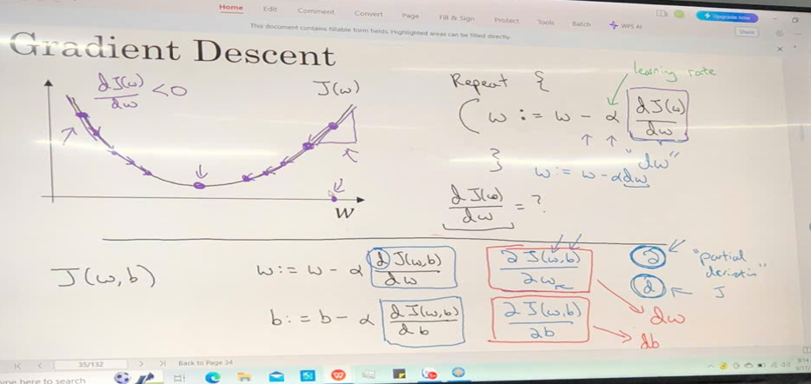
Notes:
W luôn có giá trị lớn nhất
Lear graden là hyparament tham số
W siêu tham số
Trong khoảng xanh 1 thì x đó là nhỏ nhất
Trong khoản xanh 1 tới 2 thì x 2 là nhỏ nhất
……
Nếu bài toán có nhiều điểm cực tiểu
(so sánh trực tung ,so sánh với các giá trị trước xem nào nhỏ nhất)
-nếu điểm x2 so sánh lớn hơn x1 thì sẽ đi ngược lại
(kiếm thêm trên cousera – saddle point)

Slide 16
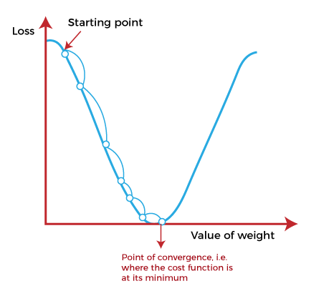
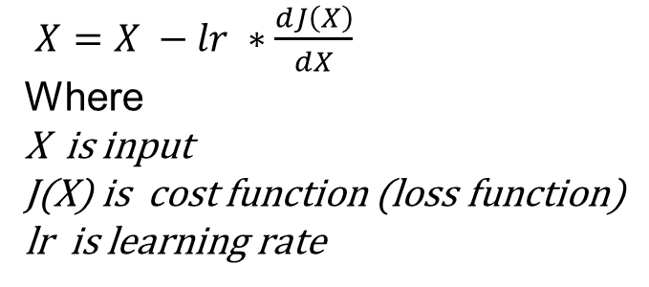
Gradient Descent
$X=X −lr ∗\frac{dJ\left(X\right)}{dX}$
Where
X is input
J(X) is cost function (loss function)
lr is learning rate

Slide 17
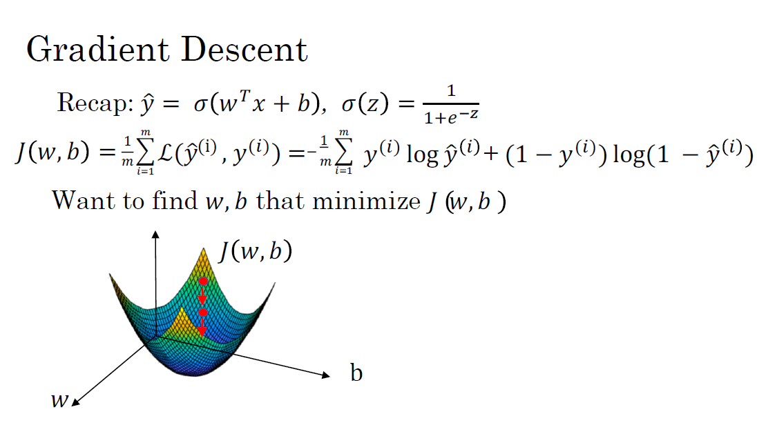

Slide 18
Basics of Neural Network Programming
Derivatives

Slide 19
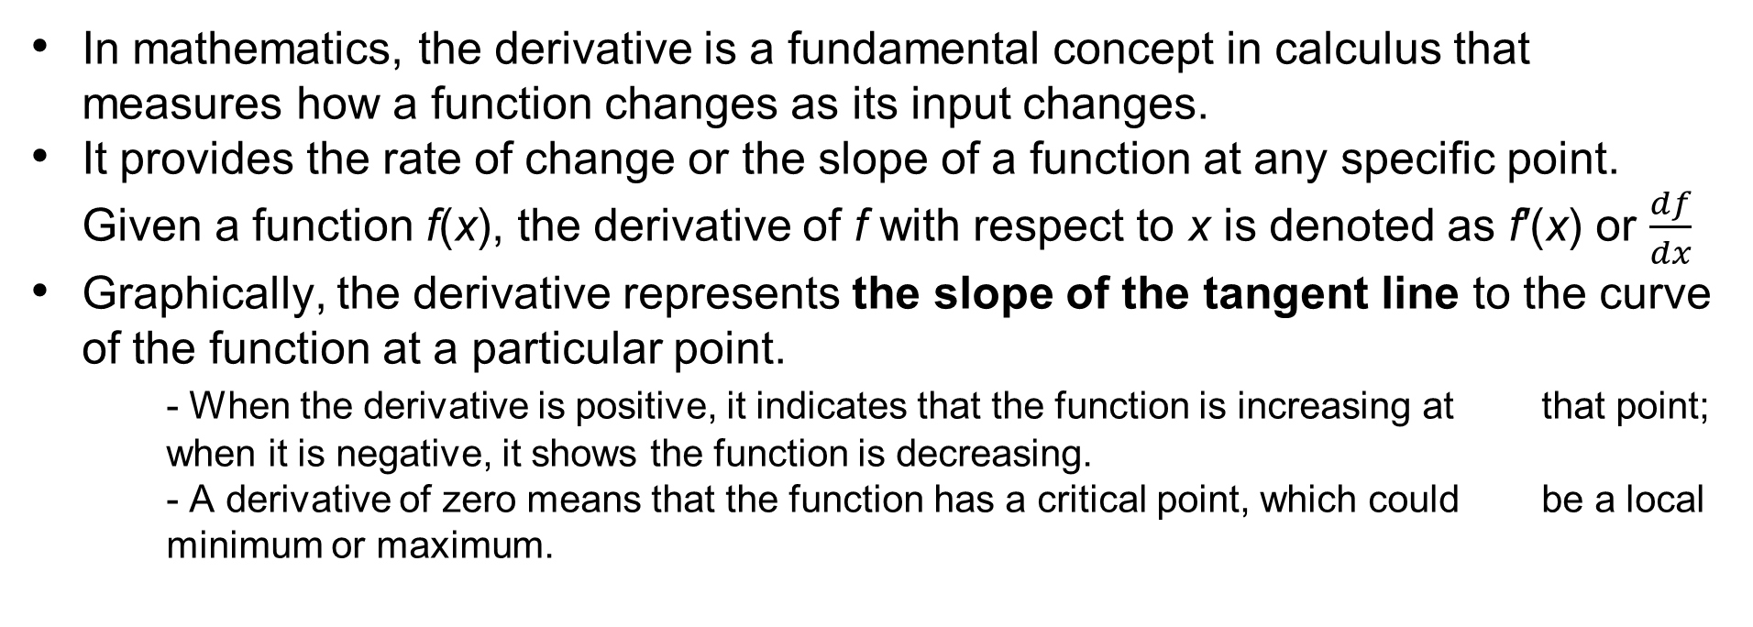
Derivatives
In mathematics, the derivative is a fundamental concept in calculus that measures how a function changes as its input changes.
It provides the rate of change or the slope of a function at any specific point. Given a function f(x), the derivative of f with respect to x is denoted as f′(x) or $\frac{df}{dx}$
Graphically, the derivative represents the slope of the tangent line to the curve of the function at a particular point.
- When the derivative is positive, it indicates that the function is increasing at that point; when it is negative, it shows the function is decreasing.
- A derivative of zero means that the function has a critical point, which could be a local minimum or maximum.
Notes:
Derivatives are a fundamental concept in calculus, and they represent the rate at which one quantity changes with respect to another.
Consider the example in the next slide is a simple linear function f(a) = 3a. To understand derivatives, look at a few points on the function and then nudging the value of a slightly to the right to see how the value of f(a) changes. When a = 2, f(a) = 6. If a is nudged to 2.001, then f(a) = 6.003. The slope of the function at a = 2 is the ratio of the change in f(a) to the change in a, which is (6.003 - 6)/(2.001 - 2) = 3. This is the same slope as the function everywhere else.
The formal definition of the derivative involves taking the limit as the change in a goes to zero. The slope or derivative of a function represents how much the output changes for a given change in the input. The slope can be different at different points on the function, and this will be explored in more detail in the next section.

Slide 20

Derivatives
The formal definition of the derivative of a function f(x) with respect to x is given by:
This definition describes the change in the function f(x) as the difference in f(x) for a small change in x (given by ℎ) approaches zero.
Consider the example in the next slide.
Notes:
Derivatives are a fundamental concept in calculus, and they represent the rate at which one quantity changes with respect to another.
Consider the example in the next slide is a simple linear function f(a) = 3a. To understand derivatives, look at a few points on the function and then nudging the value of a slightly to the right to see how the value of f(a) changes. When a = 2, f(a) = 6. If a is nudged to 2.001, then f(a) = 6.003. The slope of the function at a = 2 is the ratio of the change in f(a) to the change in a, which is (6.003 - 6)/(2.001 - 2) = 3. This is the same slope as the function everywhere else.
The formal definition of the derivative involves taking the limit as the change in a goes to zero. The slope or derivative of a function represents how much the output changes for a given change in the input. The slope can be different at different points on the function, and this will be explored in more detail in the next section.

Slide 21
Intuition about derivatives
f(a) = 3a
a = 2 f(a) = 6
a = 2.001 f(a) = 6.003
6.003
slope derivative of f(a) at a = 2 is 3
6
a = 5 f(a) = 15
a = 5.001 f(a) = 15.003
slope derivative of f(a) at a = 5 is also 3
2
2.001
a
Notes:
To understand derivatives, look at a few points on the function and then nudging the value of a slightly to the right to see how the value of f(a) changes. When a = 2, f(a) = 6. If a is nudged to 2.001, then f(a) = 6.003. The slope of the function at a = 2 is the ratio of the change in f(a) to the change in a, which is (6.003 - 6)/(2.001 - 2) = 3. This is the same slope as the function everywhere else.

Slide 22
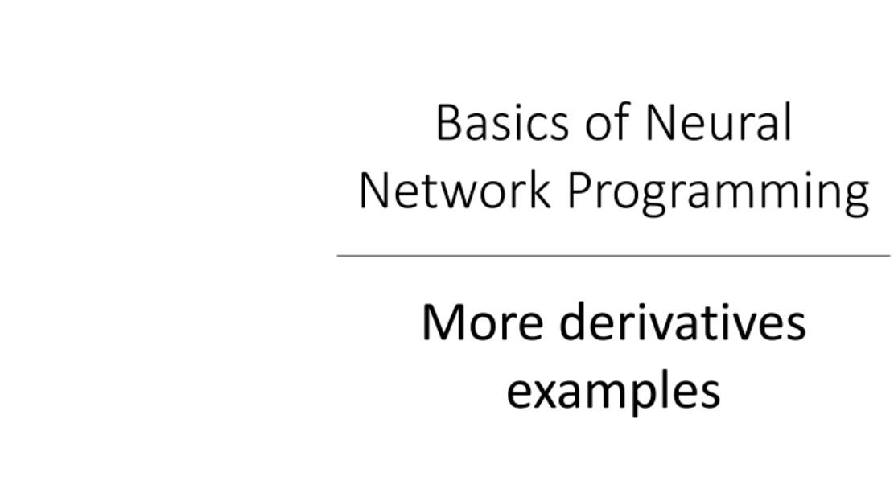

Slide 23
More derivatives examples
A derivative is the slope of a function at a particular point. The slope can be different at different points on the function, depending on the shape of the function.
For example, the function f(a) = a² has a derivative of 2a. This means that if you nudge a to the right by a small amount, say 0.001, f(a) should go up by approximately 2a times 0.001. So if a = 2, then the derivative is 4, and if you nudge a to 2.001, f(a) should go up by about 0.008.

Slide 24
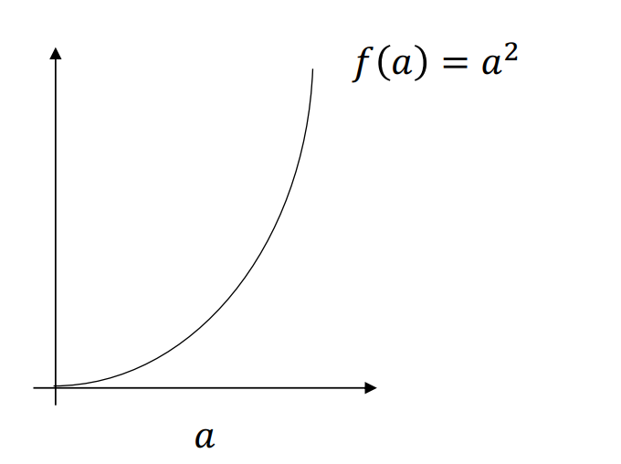

Intuition about derivatives
a = 2 f(a) = 4
a = 2.001 f(a) = 4.004
4.004
slope derivative of f(a) at a = 2 is 4
4
a = 5 f(a) = 25
a = 5.001 f(a) = 25.010
2

Slide 25
More derivatives examples
Similarly, the function f(a) = a³ has a derivative of 3a², and the function f(a) = log(a) has a derivative of 1/a. Derivatives are defined using infinitesimally small nudges to a, rather than small but finite nudges like 0.001. This means that the values of f(a) given by the derivative formula may be only approximate if you use a small but finite nudge like 0.001.

Slide 26

More derivative examples
a = 2 f(a) = 8
a = 2.001 f(a) = 8.012
f(a) = ln(a)
a = 2 f(a) = 0.69315
a = 2.001 f(a) = 0. 69365

Slide 27
Basics of Neural Network Programming
Computation Graph

Slide 28
Computation Graph
Computation graph is a way to visualize the computations of a function as a graph. The computation graph is helpful for computing derivatives or gradients of a function efficiently.
The computations of a neural network are organized in terms of a forward pass or a forward propagation step, in which we compute the output of the neural network, followed by a backward pass or back propagation step, which we use to compute gradients or compute derivatives. Computation graphs explain why it is organized this way.
Example: J = 3(a + bc).

Slide 29
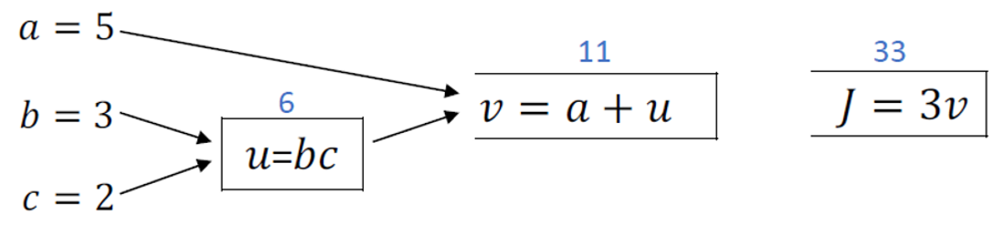
Computation Graph
Notes:
To illustrate the computation graph, a simple function J of three variables a, b, and c is considered, which is J = 3(a + bc). The computation of this function involves three steps, which are computing bc, computing a times bc, and finally, computing 3 times a times bc. These three steps can be visualized as a computation graph with three nodes: one for computing bc, one for computing a times bc, and one for computing 3 times a times bc.

Slide 30
Computation Graph
The computation graph is useful when there is a distinguished output variable, such as J in this case, that we want to optimize. The computation of J involves a left-to-right pass through the graph, which computes the value of J. In order to compute the derivatives of J, a right-to-left pass is needed, which computes the gradients or derivatives of the variables with respect to J.
In summary, the computation graph provides a way to organize the computations of a function, and it helps to efficiently compute derivatives or gradients of the function.

Slide 31
Basics of Neural Network Programming
Derivatives with a Computation Graph

Slide 32
Derivatives with a Computation Graph
Consider example of how to use a computation graph to compute a function J and then how to use it to figure out derivative calculations for J.
The computation graph organizes the computation with a left-to-right pass and a right-to-left pass. The left-to-right pass computes the value of the final output variable, J, while the right-to-left pass computes derivatives.
Computing the derivative of J with respect to v and shows how to use the chain rule to compute the derivatives of intermediate variables such as a, u, b, and c.

Slide 33
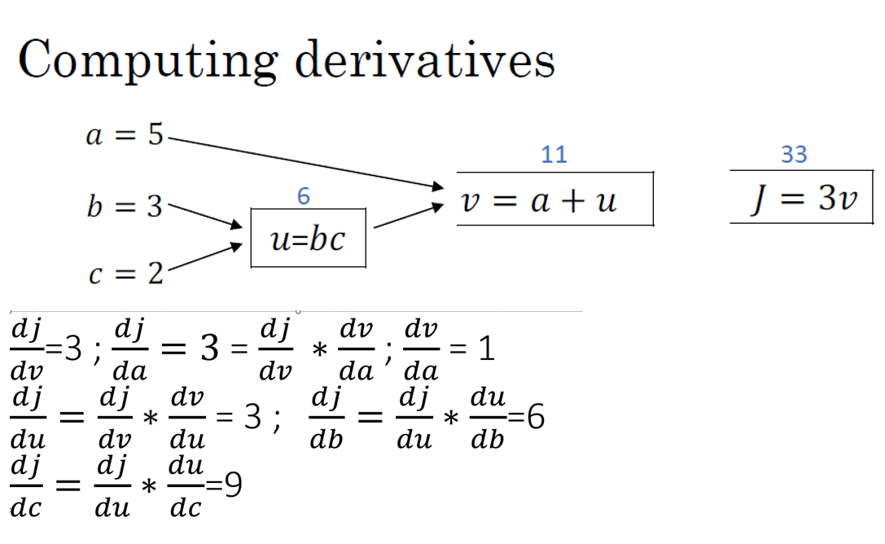

Slide 34
Basics of Neural Network Programming
Logistic Regression Gradient descent

Slide 35
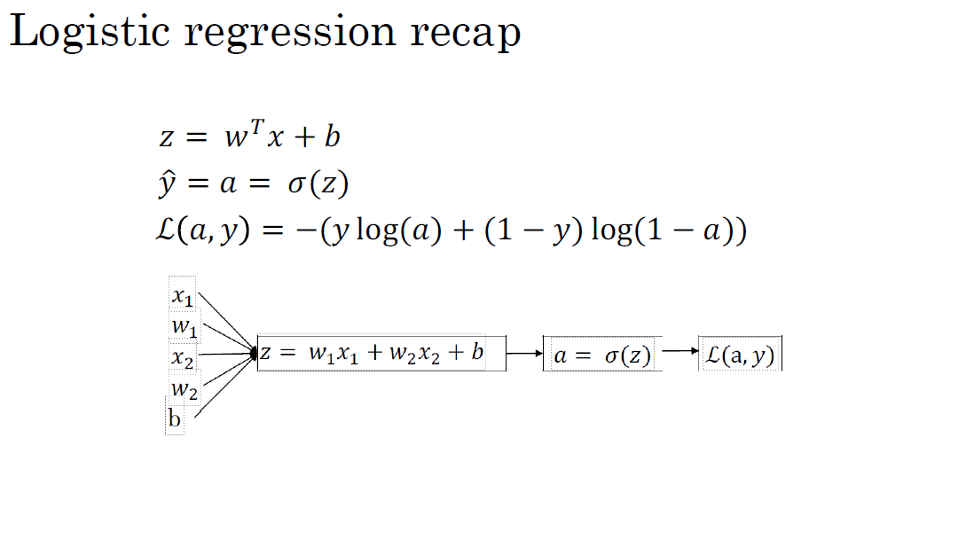
dz = df/dz = dL(a,y)/dz
= a - y
= dL/da * da/dz

Slide 36
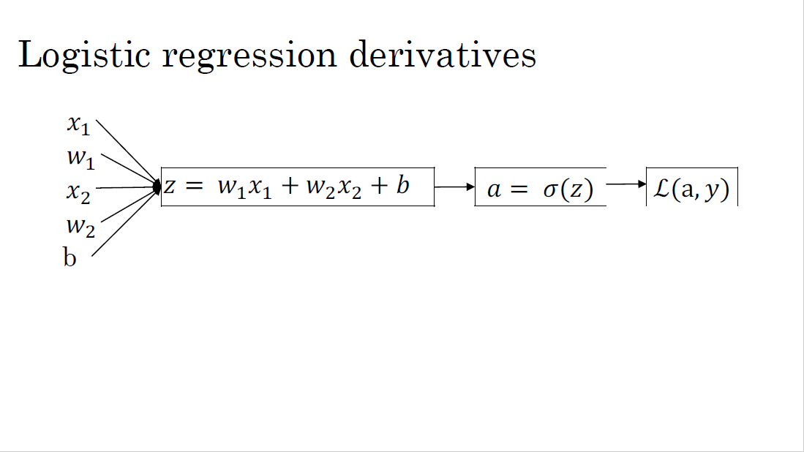

Slide 37
Basics of Neural Network Programming
Gradient descent on m examples

Slide 38
Gradient descent on m examples
To compute the derivatives of the cost function J with respect to each parameter w₁, w₂, and b, use a for loop over the m training examples (the next slide)
There are two weaknesses with this calculation:
- Firstly, two for loops are required, one over the m training examples and another over the n features.
- Secondly, explicit for loops make the algorithm run less efficiently, which is problematic when working with larger datasets. Use the concept of vectorization, which will be discussed in the next section, to address these issues.
Notes:
To compute the derivatives of the cost function J with respect to each parameter w1, w2, and b, use a for loop over the m training examples. For each training example i, computes z^{i}, the prediction a^{i}, and the derivatives dz with respect to each parameter. The derivatives are accumulated in dw1, dw2, and db, which are then divided by m to compute the average derivatives. Finally, the parameters w1, w2, and b are updated using the average derivatives and the learning rate.
There are two weaknesses with the above calculation. Firstly, two for loops are required, one over the m training examples and another over the n features. Secondly, explicit for loops make the algorithm run less efficiently, which is problematic when working with larger datasets. Use the concept of vectorization, which will be discussed in the next section, to address these issues.

Slide 39
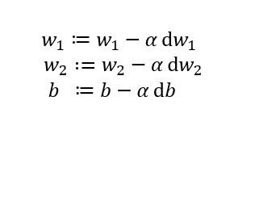
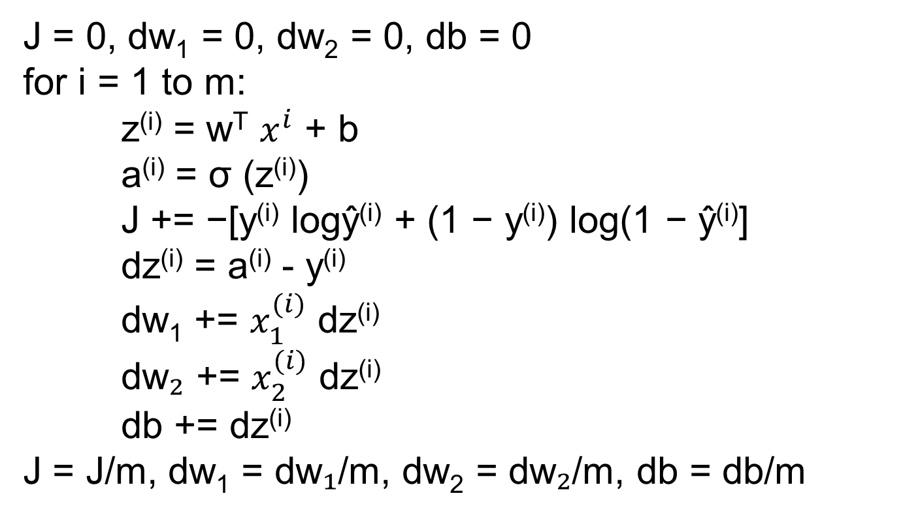
Logistic regression on m examples
J = 0, dw₁ = 0, dw₂ = 0, db = 0
for i = 1 to m:
z^{(i)} = w^{T} $x^{i}$ + b
a^{(i)} = σ (z^{(i)})
J += −[y^{(i)} logŷ^{(i)} + (1 − y^{(i)}) log(1 − ŷ^{(i)}]
dz^{(i)} = a^{(i)} - y^{(i)}
dw₁ += $x_{1}^{(i)}$ dz^{(i)}
dw₂ += $x_{2}^{(i)}$ dz^{(i)}
db += dz^{(i)}
J = J/m, dw₁ = dw₁/m, dw₂ = dw₂/m, db = db/m

Slide 40
Basics of Neural Network Programming
Vectorization

Slide 41
Vectorization
Vectorization is the process of getting rid of explicit for loops in code to make it run faster, especially in the era of deep learning where large datasets are common. The goal is to perform operations on vectors and matrices directly instead of using loops.
For example, in logistic regression, the equation
Z = W^{T}X + b can be vectorized by computing
Z = np.dot(W, X) + b.
This eliminates the need for loops and runs much faster.
In a Jupyter notebook, the np library can be used to create and manipulate arrays.
Notes:
Vectorization is the process of getting rid of explicit for loops in code to make it run faster, especially in the era of deep learning where large datasets are common. The goal is to perform operations on vectors and matrices directly instead of using loops.
For example, in logistic regression, the equation
Z = W^TX + b can be vectorized by computing np.dot(W, X) + b. This eliminates the need for loops and runs much faster.
In a Jupyter notebook, the np library can be used to create and manipulate arrays. A vectorization demo was performed by creating two million-dimensional arrays and using np.dot() to calculate the dot product. The time it took to complete was measured using the time library. A non-vectorized version was then implemented using a for loop to compute the dot product. It was found that the vectorized version took around 1.5 milliseconds to run, while the non-vectorized version took about 500 milliseconds, or 300 times longer.

Slide 42
Vectorization
A vectorization demo was performed by creating two million-dimensional arrays and using np.dot() to calculate the dot product.
A non-vectorized version was then implemented using a for loop to compute the dot product.
Vectorized version took around 1.5 milliseconds to run, while the non-vectorized version took about 500 milliseconds, or 300 times longer.
It is important to remember to vectorize code whenever possible to make it run faster. Built-in functions like np.dot() make use of parallelism instructions that allow CPUs and GPUs to execute calculations much faster.

Slide 43
Basics of Neural Network Programming
More vectorization examples

Slide 44
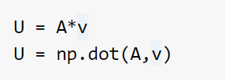
Neural network programming guideline
Whenever possible, avoid explicit for-loops.

Slide 45
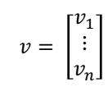
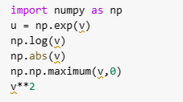
Vectors and matrix valued functions
Say you need to apply the exponential operation on every element of a matrix/vector.
u = np.zeros((n,1)) for i in range(n): u[i]=math.exp(v[i])

Slide 46
Basics of Neural Network Programming
Vectorizing Logistic Regression

Slide 47
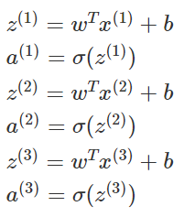
Vectorizing Logistic Regression
Consider the four propagation steps of logistic regression, which include computing the activation values for each training example. So, if you have M training examples, you need to do this M times.

Slide 48
Vectorizing Logistic Regression
Use a (N_{x} by M) matrix.
Use this matrix to compute Z=Z⁽¹⁾ Z⁽²⁾ Z⁽³⁾ ... Z^{(n)} with one line of code. The matrix Z is a 1 by M matrix that's really a row vector.
Using matrix multiplication Z=W^{T}X+b can be computed to obtain Z in one step.
The python command is : z = np.dot(w.T, X) + B
Here W = (N_{X} by 1), X is (N_{X} by M) and b is (1 by M), multiplication and addition gives Z (1 by M).

Slide 49
Basics of Neural Network Programming
Vectorizing Logistic Regression’s Gradient Output

Slide 50
Vectorizing Logistic regression
J = 0, dw₁ = 0, dw₂ = 0, db = 0
for i = 1 to m:
z^{(i)} = w^{T} $x^{i}$ + b
a^{(i)} = σ (z^{(i)})
J += −[y^{(i)} logŷ^{(i)} + (1 − y^{(i)}) log(1 − ŷ^{(i)}]
dz^{(i)} = a^{(i)} - y^{(i)}
dw₁ += $x_{1}^{(i)}$ dz^{(i)}
dw₂ += $x_{2}^{(i)}$ dz^{(i)}
db += dz^{(i)}
J = J/m, dw₁ = dw₁/m, dw₂ = dw₂/m, db = db/m

Slide 51
Vectorizing Logistic Regression
Vectorization also performs the gradient computations for all M training samples. To derive a very efficient implementation of logistic regression.
For the gradient computation , the first step is to compute dz⁽¹⁾ for the first example, which could be a⁽¹⁾−y⁽¹⁾ and then dz⁽²⁾ = a⁽²⁾−y⁽²⁾ and so on. And so on for all M training examples.

Slide 52
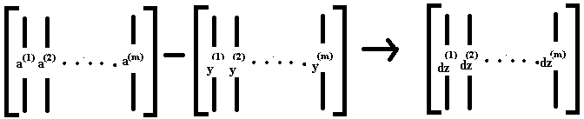
Vectorizing Logistic Regression
Lets define a new variable , dZ is going to be dz⁽¹⁾ , dz⁽²⁾,..., dz^{(m)}. Again, all the lowercase z variables stacked horizontally. So, this would be 1 by m matrix or alternatively a 'm' dimensional row vector.
Previously , we'd already figured out how to compute A and Y as shown below and you can see for yourself that dz can be computed as just A minus Y because it's going to be equal to a⁽¹⁾ – y⁽¹⁾, a⁽²⁾ – y⁽²⁾, and so on.
So, with just one line of code , you can compute all of this at the same time. By a simple matrix subtraction as shown below.

Slide 53
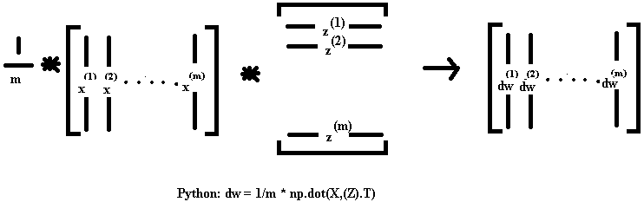
Vectorizing Logistic Regression
To compute dw , we initialize dw to zero to a vector of zeroes. Then we still have to loop over examples where we have dw + = x⁽¹⁾ * dz⁽¹⁾, for the first training example and so on.

Slide 54
Vectorizing Logistic Regression
Similarly for the vectorize implementation of db was doing is basically summing up, all of these dzs and then dividing by m. This can be done using just one line in python as: db = 1/m * np.sum(dz)
And so the gradient descent update then would be you know W gets updated as w minus the learning rate times dw which was just computed above and B is update as B minus the learning rate times db.
We should get rid of explicit full loops whenever you can but if you want to implement multiple adjuration as a gradient descent then you still need a full loop over the number of iterations. So, if you want to have a thousand deliberations of gradient descent, you might still need a full loop over the iteration number.
There is an outermost full loop like that then I don't think there is any way to get rid of that full loop.
A technique in python which makes our code easy for implementation is called broadcasting.

Slide 55
Basics of Neural Network Programming
Broadcasting in Python

Slide 56
Broadcasting in Python
Broadcasting in Python is a technique that allows you to perform mathematical operations between arrays or matrices of different sizes without explicitly iterating over them using a for-loop.
The principle of broadcasting is that when you perform an operation between arrays or matrices of different sizes, NumPy will automatically copy the smaller array or matrix to match the size of the larger one, and then perform the operation element-wise.
In the example in the next slide, a three by four matrix representing the number of calories from carbohydrates, proteins, and fats in 100 grams of four different foods was used. The goal was to calculate the percentage of calories from carbs, proteins, and fats for each of the four foods.
Notes:
Broadcasting in Python is a technique that allows you to perform mathematical operations between arrays or matrices of different sizes without explicitly iterating over them using a for-loop.
The principle of broadcasting is that when you perform an operation between arrays or matrices of different sizes, NumPy will automatically copy the smaller array or matrix to match the size of the larger one, and then perform the operation element-wise.
In the example in the next slide, a three by four matrix representing the number of calories from carbohydrates, proteins, and fats in 100 grams of four different foods was used. The goal was to calculate the percentage of calories from carbs, proteins, and fats for each of the four foods. This was achieved by summing down the columns of the matrix to get the total number of calories in 100 grams of each food, and then dividing each element of the matrix by its corresponding sum to get the percentage of calories from each nutrient.

Slide 57
Broadcasting example
Calories from Carbs, Proteins, Fats in 100g of different foods:
Apples
Beef Eggs
Potatoes
Carb Protein
56.0
1.2
0.0 4.4 6.8
104.0 52.0 8.0
135.0 99.0 0.9
Fat 1.8
cal = A.sum(axis = 0)
percentage = 100*A/(cal.reshape(1,4))

Slide 58
Broadcasting in Python
The code used to achieve this involved two lines. The first line used the sum function to sum down the columns of the matrix, and the second line divided each element of the matrix by its corresponding sum. The reshape function was used to ensure that the dimensions of the arrays were compatible for the division operation.

Slide 59
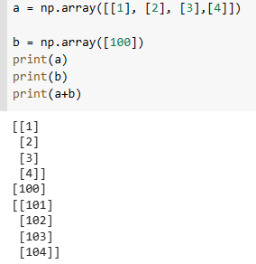
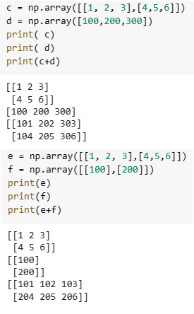
Broadcasting example
1
2
3
4
+
100
1 2 3
4 5 6
+
100 200 300
101 202 303
⁼ 104 205 306
1 2 3
4 5 6
100
200
101 102 103
204 205 206
+

Slide 60
Broadcasting in Python
Broadcasting in Python is a powerful tool that can greatly simplify your code and make it run faster. It can be used for a wide range of operations, including addition, subtraction, multiplication, and division.
There are some tips and tricks that can help reduce the number of bugs in your Python code. These include using descriptive variable names, writing modular code, commenting your code, testing your code frequently, and using version control. These tips can help you write cleaner, more efficient code that is easier to debug and maintain.

Slide 61
Basics of Neural Network Programming
Explanation of logistic regression cost function (Optional)

Slide 62
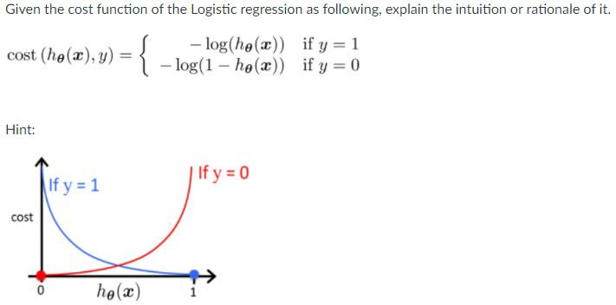
Logistic regression cost function

Slide 63
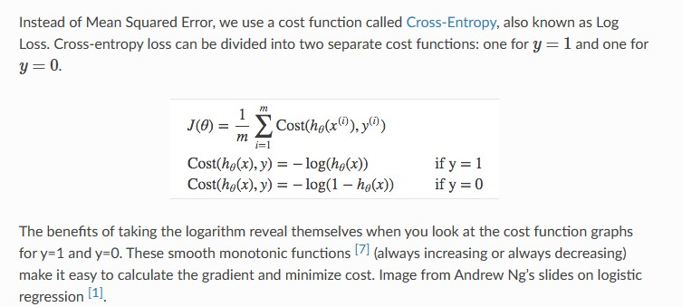
Logistic regression cost function

Slide 64
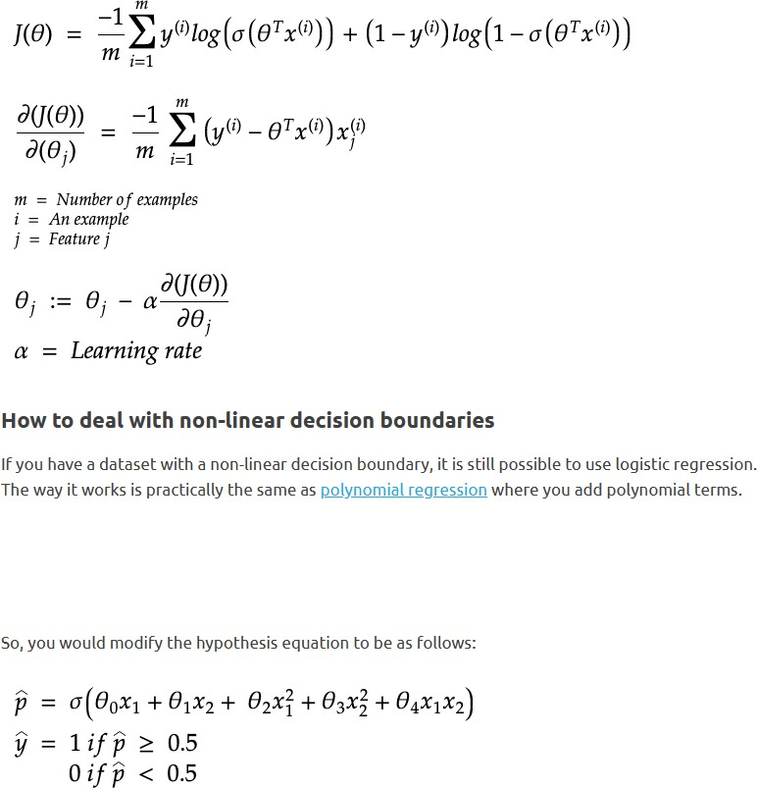
Cost on m examples

Slide 65
Summarization
Logistic regression, a binary classification algorithm, can be viewed as a single-layer neural network, employing input features, weights, a bias term, and a sigmoid activation for predictions.
For efficiency, use matrix operations and vectorized computations, minimizing loops and leveraging library functions.
Derivatives are calculated for gradient descent.
Vectorization processes multiple training examples concurrently, using matrices for parallel operations.
Broadcasting, facilitating element-wise operations between arrays of different shapes, is employed in libraries like NumPy.
Notes:
Logistic Regression Model Structured as a Shallow Neural Network:
- Logistic regression, a binary classification algorithm, can be conceptualized as a single- layer neural network.
- The input features are multiplied by weights, summed with a bias term, and passed through a sigmoid activation function to predict binary outcomes.
Implementing Computationally Efficient and Highly Vectorized Models:
- Utilize matrix operations and vectorized computations for efficient training.
Minimize explicit loops and leverage library functions to perform operations on entire datasets.
Derivatives for Logistic Regression:
- Calculate the derivative of the cost function with respect to model parameters (weights and bias) to determine the direction of gradient descent.
Vectorization Across Multiple Training Examples:
- Vectorize calculations to process multiple training examples simultaneously.
- Utilize matrices to represent multiple examples and perform operations in parallel.
The Concept of Broadcasting:
- Broadcasting allows element-wise operations between arrays of different shapes.
- In NumPy or similar libraries, smaller arrays are "broadcasted" to match the shape of larger arrays, facilitating efficient computations.

